Slide 1

Medical Document Classification Using Deep Learning and Unsupervised Topic Modeling

Slide 2
Project Description
This project will be focusing on a machine learning area that frequently uses both supervised and unsupervised models, that being natural language processing.
We will be exploring and creating two models for a medical dataset containing research papers on 3 different types of cancer: Thyroid, Lung and Colon.
In many cases text classification of medical documents primarily consists of unstructured free text that clinicians need to group together and harmonize in a timely manner. NLP helps to automate this process by making sense of these massive amounts of textual data.
For this project we will be employing an unsupervised learning model called Latent Dirichlet Allocation (LDA) and a deep learning algorithm known as a bidirectional LSTM. The goal is to correctly assess whether the publication is discussing colon cancer, lung cancer, or thyroid cancer. After deploying both of these models we will compare each and discuss the pros and cons of each.

Slide 3
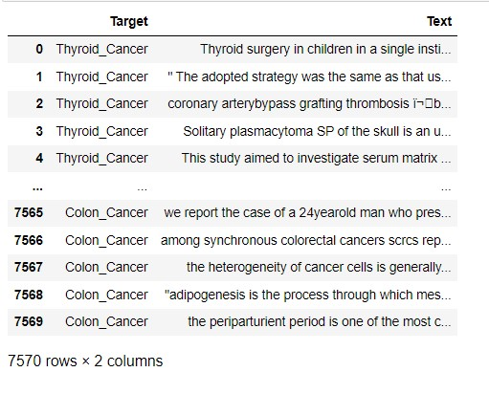
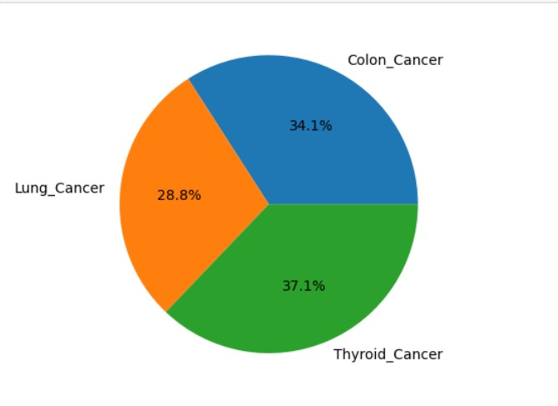
Data Description
We will be using a dataset from Kaggle. The title of the dataset is "Medical Text Dataset -Cancer Doc Classification." There are a total of 7569 publications in the dataset with two useful columns. Those being the class label column where we have our three target cancers listed and the text column, where we have our publications' text.

Slide 4
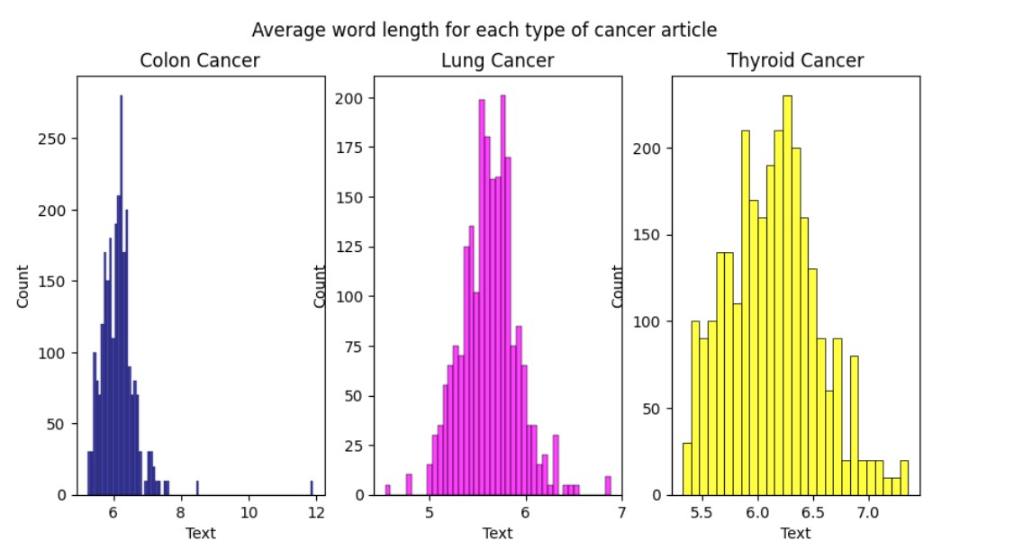
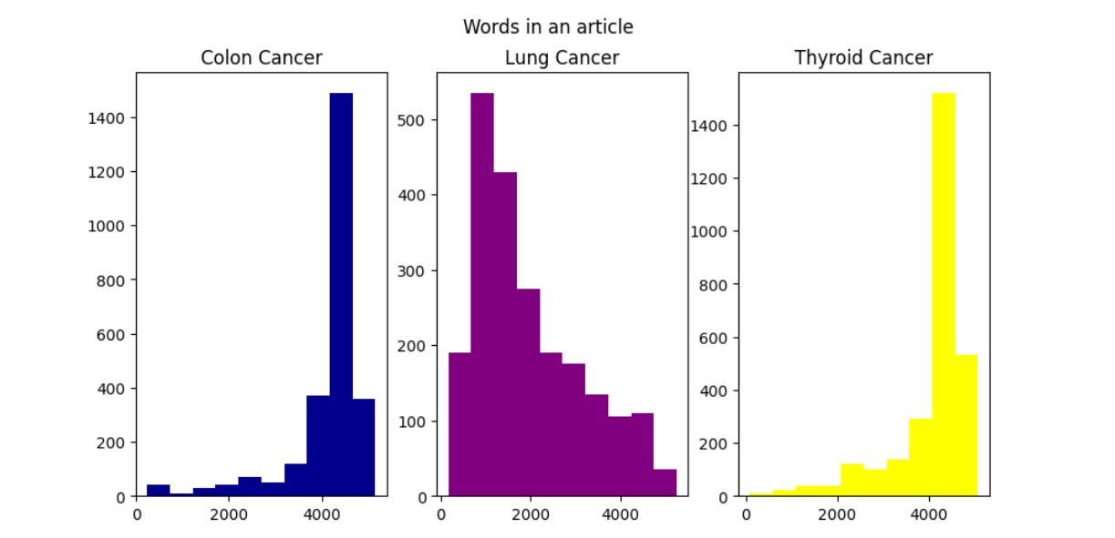
Exploratory Data Analysis

Slide 5
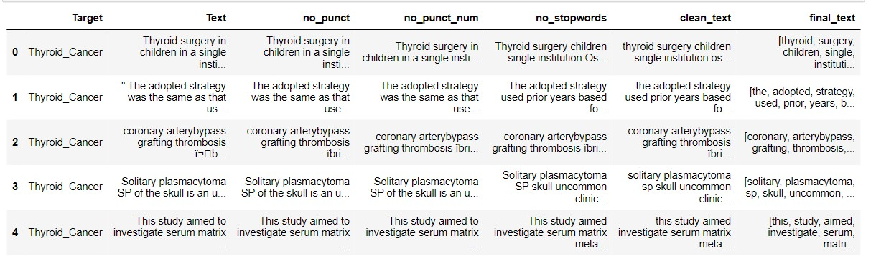
Data Cleaning and Preprocessing
A cleaning function was created, where extra spaces, punctuation, stop words and numbers in words were removed. Additionally, all text was made lowercase and tokenized.

Slide 6
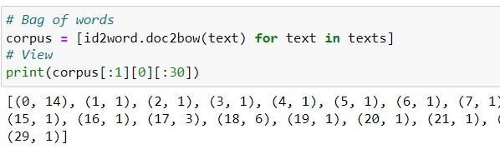

Word Vectorization
Our hyperparameters in this scenario were the ways we vectorized our text and fed it into the LDA. Using both the bag of words approach as well as the TF-IDF approach produced similar results. The primary difference between the two approaches is that compared to regular term frequency BOW, the TF-IDF weighting scheme gives more weight to words which appear in fewer documents and less weight to words which appear in many documents.

Slide 7
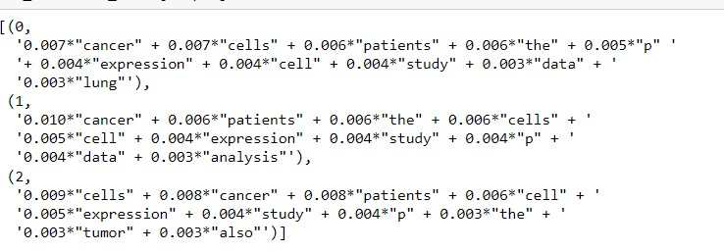
Model Building
Latent Dirichlet Allocation is a topic modeling technique used to extract topics from a corpus. Latent in this context means something is hidden and is yet to be discovered. The Dirichlet model part of LDA describes the pattern of the words that are repeating together, or occurring frequently, using probability distributions to do this. In the case of topic modeling, the process helps in estimating what are the chances of the words, which are spread over the document, will occur again?

Slide 8
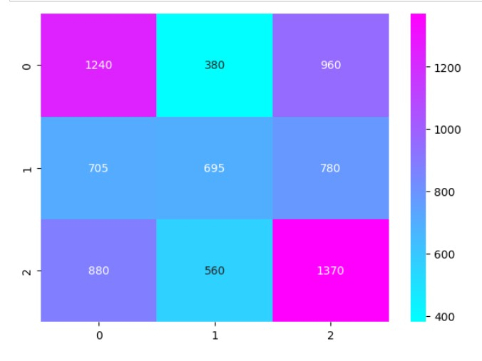
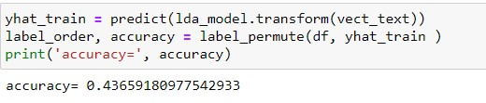
Evaluation of Models
Above we can see that our confusion matrix here is all over the place in terms of picking the 3 topics. Although, we can see that topics 0 and 2 did perform slightly better than topic 1. Those topics were lung cancer and colon cancer. Our hyperparameters in this scenario were the ways we vectorized our text and fed it into the LDA. Using both the bag of words approach as well as the TF-IDF approach produced similar results.

Slide 9
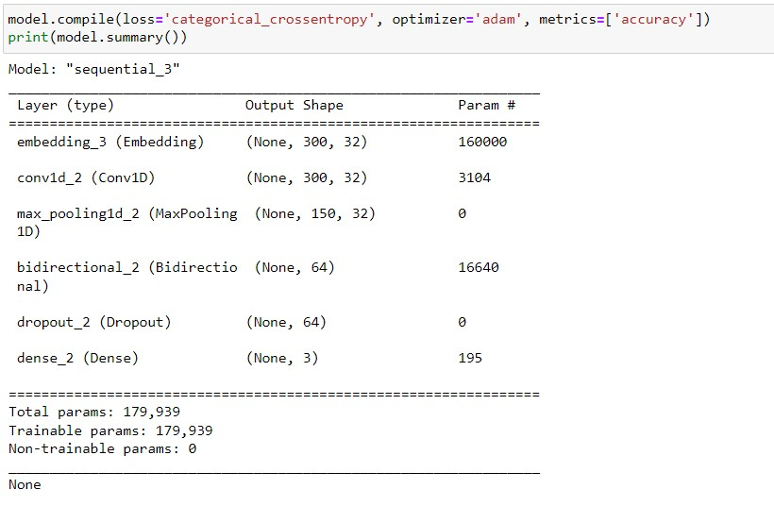
Model Building cont.
Long short-term memory (LSTM) networks are an extension of a recurrent neural network (RNN) that extend memory. An RNN uses feedback loops which makes it different from other neural networks. Those loops help the RNN to process the sequence of the data. LSTMs were introduced to avoid the long-term dependency problem of RNNs. In a regular RNN, the problem frequently occurs when connecting previous information to new information.
In a bidirectional LSTM, our input flows in two directions, making a bi-lstm different from the regular LSTM. With the regular LSTM, we can make input flow in one direction, either backwards or forward. However, in bi-directional, we can make the input flow in both directions to preserve the future and the past information.

Slide 10
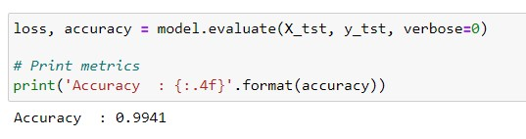
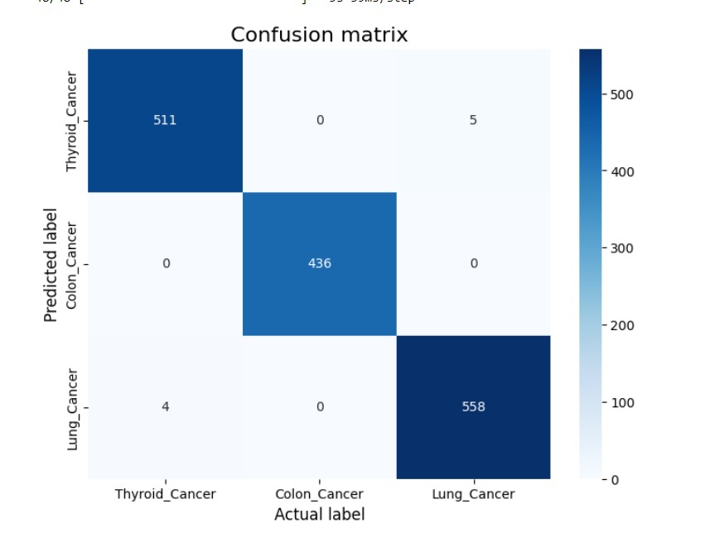
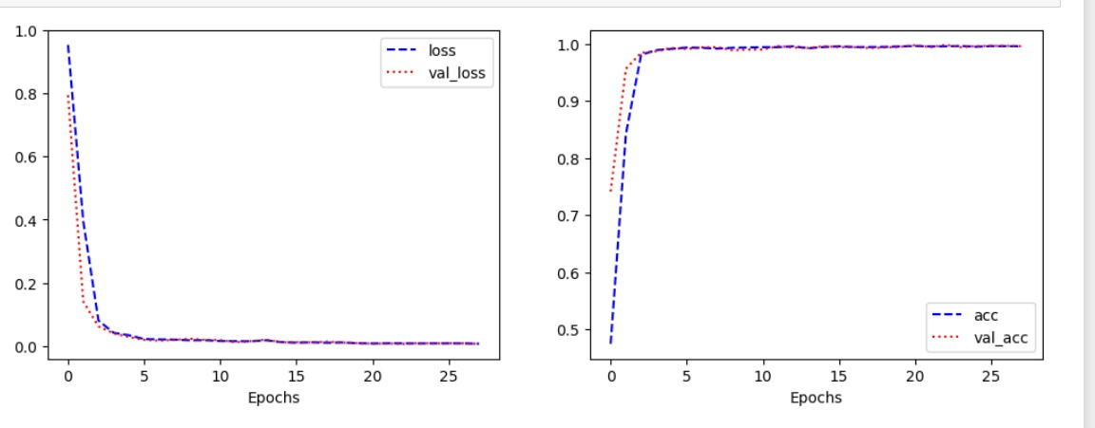
Evaluation cont.

Slide 11
Conclusion
The first question we should be asking ourselves is what went wrong in the LDA model and what went right in the LSTM model? LDA is a probabilistic model, which means that it is not always accurate. Additionally, LDA can be slow to converge on a good solution. Lastly, LDA does not work well with short documents, although our text was not incredibly short, 2000-4000 words may have not been enough. For the LSTM, we can attribute the success of the model to many different things, simply put though the architecture for the model allows it to exhibit temporal behavior and capture sequential data which makes it a more 'natural' approach when dealing with textual data since text is naturally sequential. Further research could be done on when other topic modeling algorithms could be applied in scenarios like these on unlabeled data and still achieve superior results like the LSTM model had.

